Slide 1
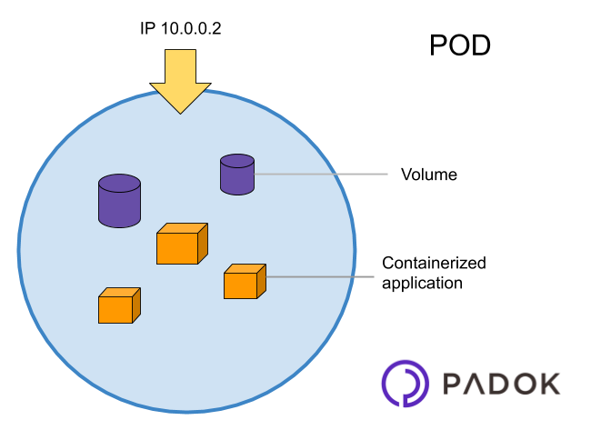
Pods
A pod is the smallest element of scheduling in Kubernetes. Without it, a container cannot be part of a cluster.
If you need to scale your app, you can only do so by adding or removing pods.
The pod serves as a ‘wrapper’ for a single container with the application code.
Based on the availability of resources, the Master schedules the pod on a specific node and coordinates with the container runtime to launch the container.

Slide 2
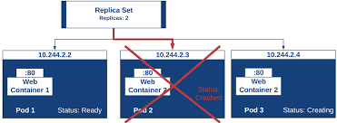
Replica sets
A ReplicaSet (RS) is a Kubernetes object used to maintain a stable set of replicated pods running within a cluster at any given time.
A ReplicaSet is a process that runs multiple instances of a Pod and keeps the specified number of Pods constant. Its purpose is to maintain the specified number of Pod instances running in a cluster at any given time to prevent users from losing access to their application when a Pod fails or is inaccessible.
ReplicaSet helps bring up a new instance of a Pod when the existing one fails, scale it up when the running instances are not up to the specified number, and scale down or delete Pods if another instance with the same label is created.
A ReplicaSet ensures that a specified number of Pod replicas are running continuously and helps with load-balancing in case of an increase in resource usage.

Slide 3
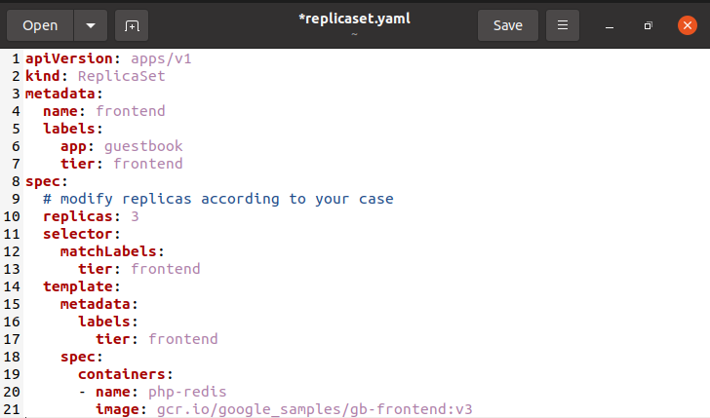
Replica set configuration

Slide 4
jobs
The main function of a job is to create one or more pod and tracks about the success of pods. They ensure that the specified number of pods are completed successfully. When a specified number of successful run of pods is completed, then the job is considered complete.
Scheduled job in Kubernetes uses Cronetes, which takes Kubernetes job and launches them in Kubernetes cluster.
Scheduling a job will run a pod at a specified point of time.
A parodic job is created for it which invokes itself automatically.
We have replicaset, Daemonset, statefulset and deployments they all share some common property :they ensure that the pods are always running if a pod fails, the controllers restarts it or reschedules it to another node to make sure that the application pods is hosting keeps running.
Use cases
To backup of a DB
Helm charts uses jobs
Running batch process
Run a task at a schedule interval
Log rotation

Slide 5
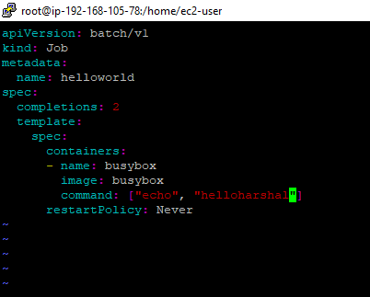
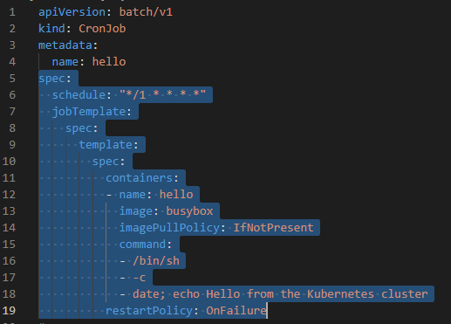
Job set configuration

Slide 6
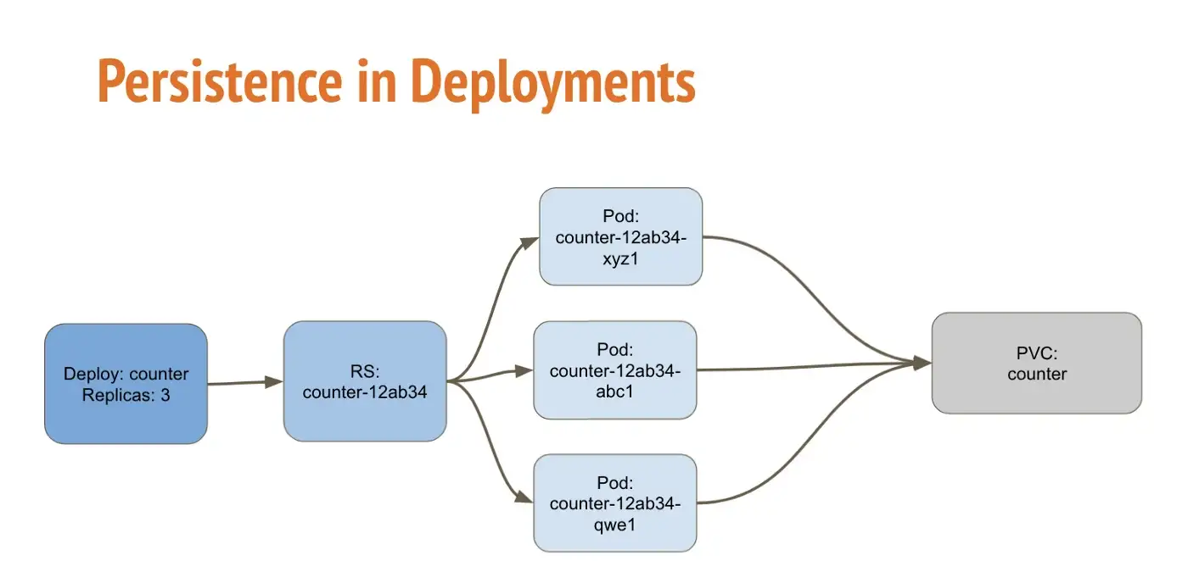
Deployment
Deployment is the easiest and most used resource for deploying your application. It is a Kubernetes controller that matches the current state of your cluster to the desired state mentioned in the Deployment manifest.
e.g. If you create a deployment with 1 replica, it will check that the desired state of ReplicaSet is 1 and current state is 0, so it will create a ReplicaSet, which will further create the pod. If you create a deployment with name counter, it will create a ReplicaSet with name counter-<replica-set-id>, which will further create a Pod with name counter-<replica-set->-<pod-id>.
Deployments are usually used for stateless applications. However, you can save the state of deployment by attaching a Persistent Volume to it and make it stateful, but all the pods of a deployment will be sharing the same Volume and data across all of them will be same.
It controls on the replica set. It provide declarative update for pods and replica sets.
Stateless application:-A Stateless app is an application program that does not save client data generated in one session for use in the next session with that client.
Eg:-java, python

Slide 7
Use cases of deployment
Create a deployment to roll out a Replicaset ,the replica creates pods in the background check the status of the rollout to see if it succeed or not.
Declare the new state of the pods by updating the pod template of the deployment .a new replicaset is created and the deployment manages moving the pod from old replicaset to new one at a controlled rate each new replicaset updates the revision of the deployment.
Rollback to an earlier deployment revision if the current state of the deployment is not stable each rollback updates the revision of the deployment.
Scale up the deployment to facilities more load.
Pause the deployment to apply multiple fixes to its pod template spec and then resume it to start a new rollout.
Cleanup older replica sets that you don’t need anymore.
If there are problem in the deployment kubernetes will automatically rollback to the previous version however you can explicitly rollback to a specific version , as in our case to revision1.

Slide 8
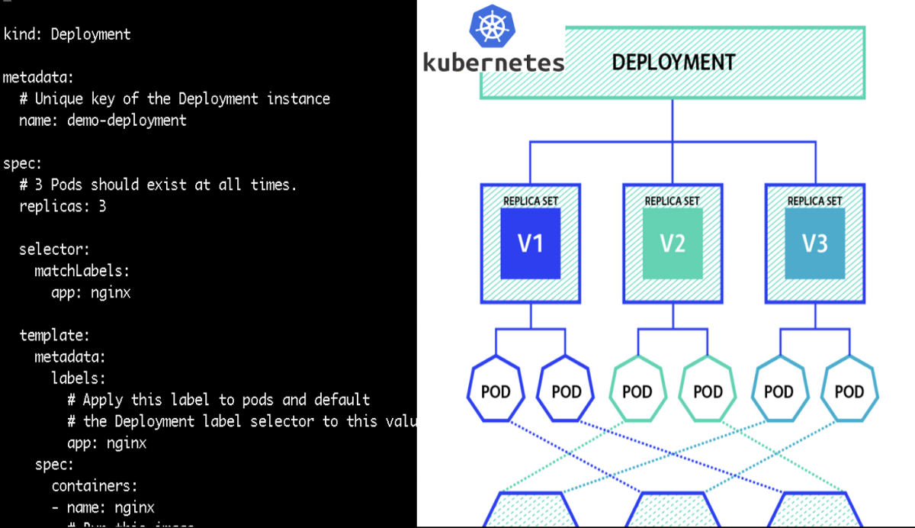
Deployment configuration

Slide 9
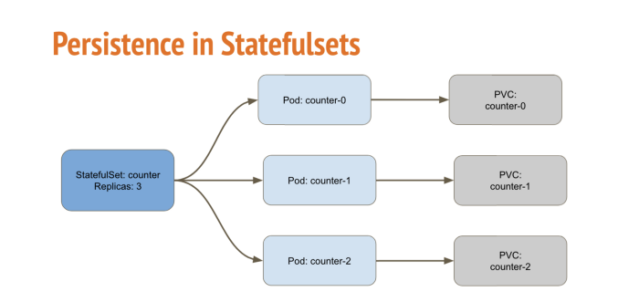
Stateful sets
A StatefulSet is a Kubernetes resource object that manages a set of pods with unique identities. By assigning a persistent ID that is maintained even if the pod is rescheduled, a StatefulSet helps maintain the uniqueness and ordering of pods. With unique pod identifiers, administrators can efficiently attach cluster volumes to new pods across failures.
Although the StatefulSet controller deploys pods using similar specifications, pods are not interchangeable. As a StatefulSet does not create a ReplicaSet, the pod replicas cannot be rolled back to previous versions. StatefulSets are typically used for applications that require persistent storage for stateful workloads, and ordered, automated rolling updates.
e.g. If you create a StatefulSet with name counter, it will create a pod with name counter-0, and for multiple replicas of a statefulset, their names will increment like counter-0, counter-1, counter-2, etc.
Stateful Application:- Stateful applications save data to persistent disk storage for use by the server, by clients, and by other applications.
Eg:- mysql, mangoDB

Slide 10
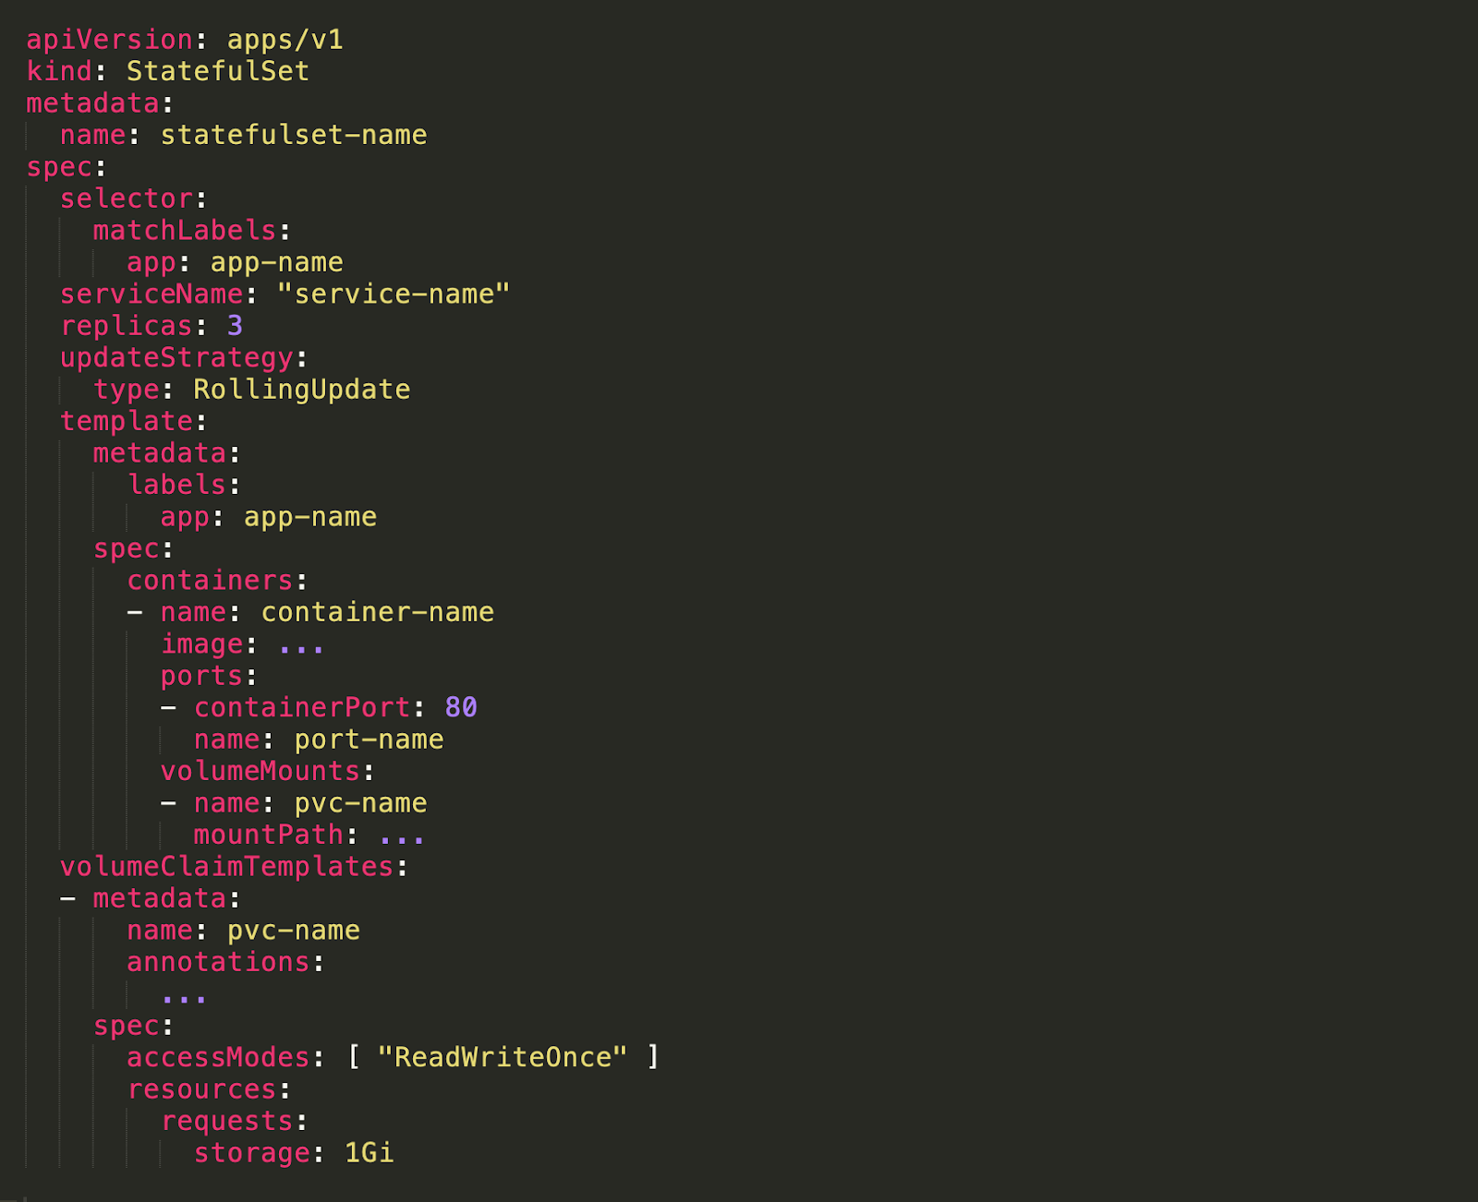
Statefulset configuration

Slide 11
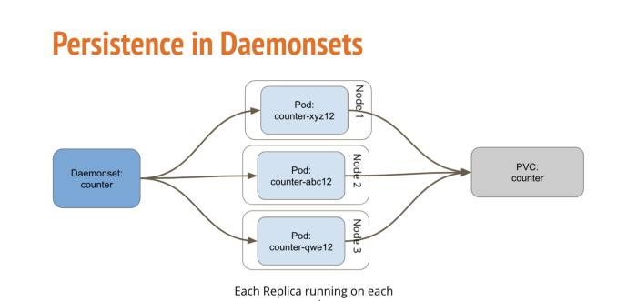
Daemonset
A DaemonSet is a controller that ensures that the pod runs on all the nodes of the cluster. If a node is added/removed from a cluster, DaemonSet automatically adds/deletes the pod.
Some typical uses of a DaemonSet are:
running a cluster storage daemon on every node
running a logs collection daemon on every node
running a node monitoring daemon on every node
When you deploy the daemonset, it will create pods equal to the number of nodes. In terms of behavior, it will behave the same as Deployments i.e. all pods will share the same Persistent Volume.

Slide 12
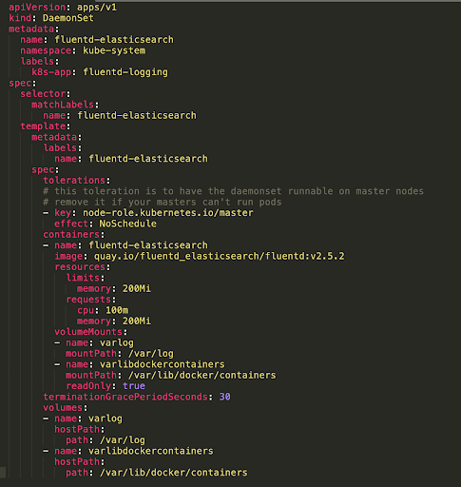
Daemonset configuration

Slide 13
DEPLOYMENT
STATEFULSET
Daemonset
Stateless
Stateful
*Pods are assigned an ID that consists of the deployment name and a random hash to generate a temporarily unique identity
*Each pod gets a persistent identity consisting of the StatefulSet name and a sequence number
*A DaemonSet ensures that all eligible nodes run a copy of a Pod
*DaemonSet is a controller similar to ReplicaSet that ensures that the pod runs on all the nodes of the cluster
*Pods are identical and can be interchanged
*Pods in a StatefulSet are neither identical nor interchangeable
*A pod can be replaced by a new replica at any time
*Pods retain their identity when rescheduled on another node
*DaemonSets share similar functionality with ReplicaSets
*All replicas share a PVC and a volume
*Each pod gets a unique volume and PVC
*one PVC will be created that all pods will be sharing.
*Requires a service to interact with the pods
*The headless service handles pod network identities
*A DaemonSet is an independent object that has its own controller
*Pods are created and deleted randomly
*Pods are created in a strict sequence and cannot be deleted randomly

